Slide 1
PIZZA SALES

Slide 2
HELLO !
My name is Samarth Pagar and in this project I have utilized SQL Queries to solve question which were
related to Pizza Sales.

Slide 3
CONTENTS
1. Retrieve the total number of orders placed.
2. Calculate the total revenue generated from pizza sales.
3. Identify the highest-priced pizza.
4. Identify the most common pizza size ordered.
5. List the top 5 most ordered pizza types along with their quantities.

Slide 4
CONTENTS
6. Join the necessary tables to find the total quantity of each pizza category ordered.
7. Determine the distribution of orders by hour of the day.
8. Join relevant tables to find the category-wise distribution of pizzas.
9. Group the orders by date and calculate the average number of pizzas ordered per day.
10. Determine the top 3 most ordered pizza types based on revenue.

Slide 5
CONTENTS
11. Calculate the percentage contribution of each pizza type to total revenue.
12. Analyze the cumulative revenue generated over time.
13. Determine the top 3 most ordered pizza types based on revenue for each pizza category.

Slide 6
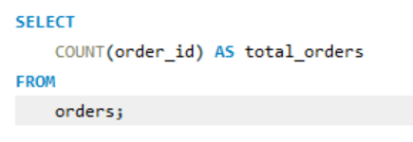
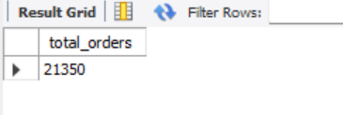
Retrieve the total number of orders placed.

Slide 7
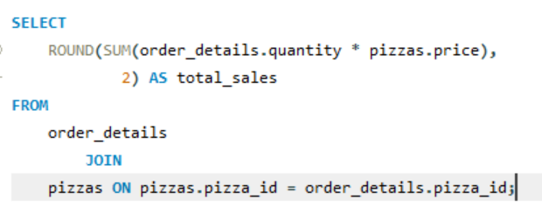
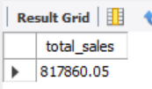
Calculate the total revenue generated from pizza sales.

Slide 8
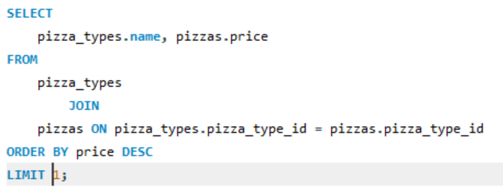
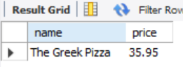
Identify the highest-priced pizza.

Slide 9
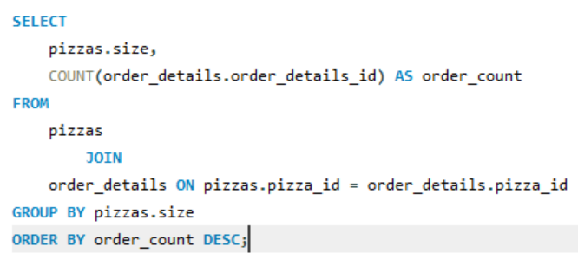
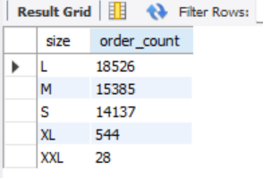
Identify the most common pizza size ordered.

Slide 10
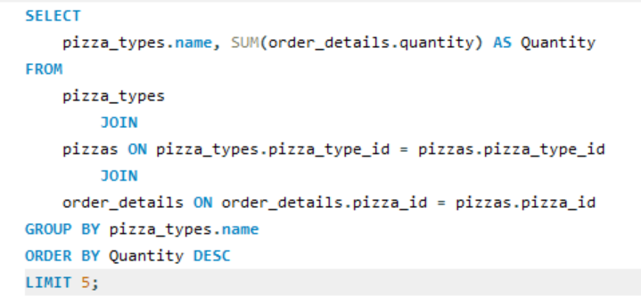
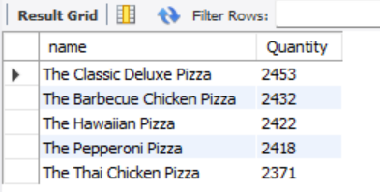
List the top 5 most ordered pizza types along with their quantities.

Slide 11
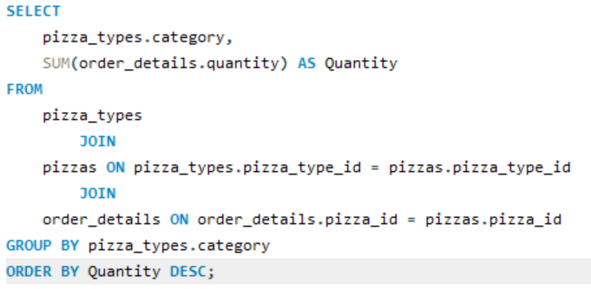
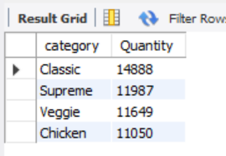
Join the necessary tables to find the total quantity of each pizza category ordered.

Slide 12
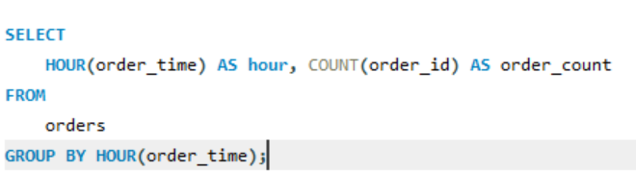
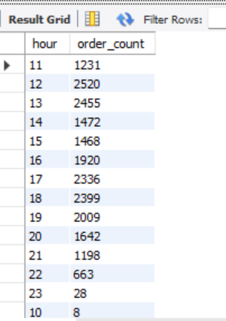
Determine the distribution of orders by hour of the day.

Slide 13
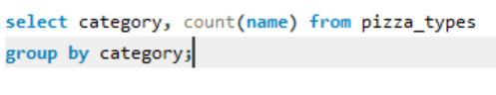
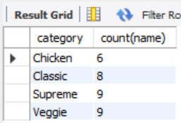
Join relevant tables to find the category-wise distribution of pizzas.

Slide 14
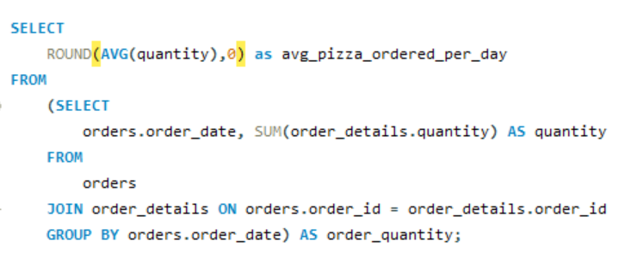
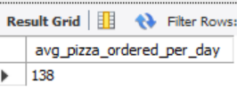
Group the orders by date and calculate the average number of pizzas ordered per day.

Slide 15
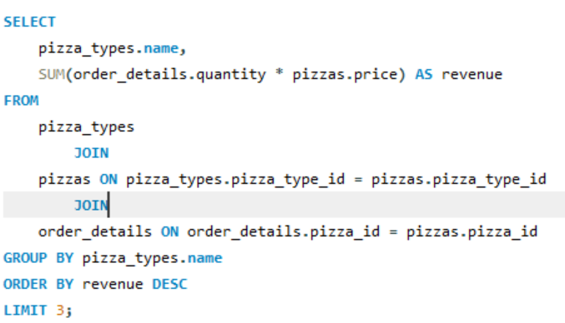
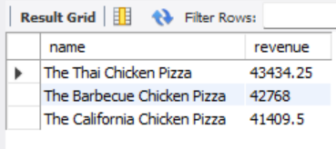
Determine the top 3 most ordered pizza types based on revenue.

Slide 16
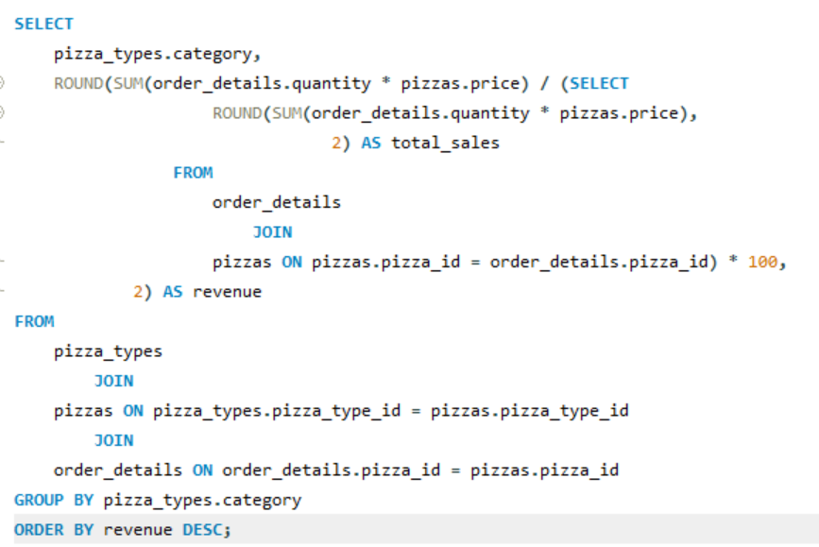
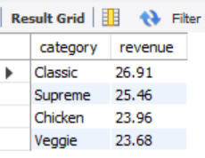
Calculate the percentage contribution of each pizza type to total revenue.

Slide 17
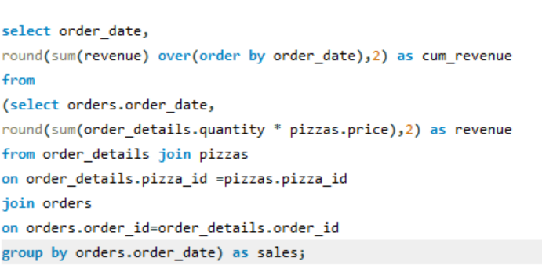
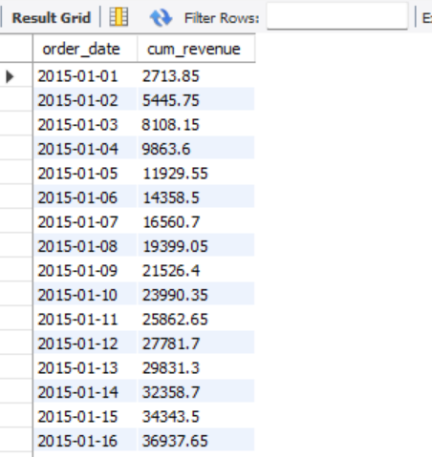
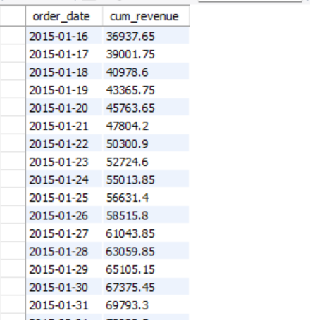
Analyze the cumulative revenue generated over time.

Slide 18
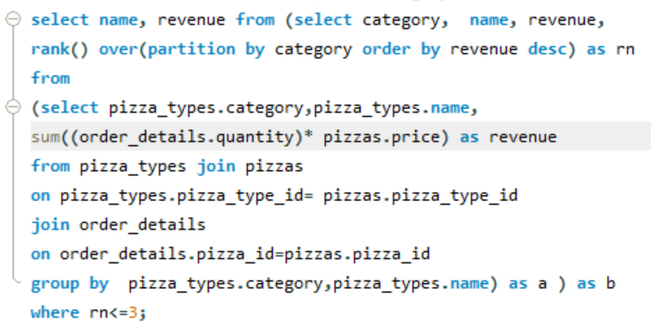
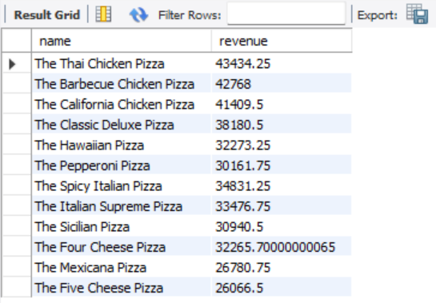
Determine the top 3 most ordered pizza types based on revenue for each pizza category.

Slide 19
THANK YOU

